Slide 1
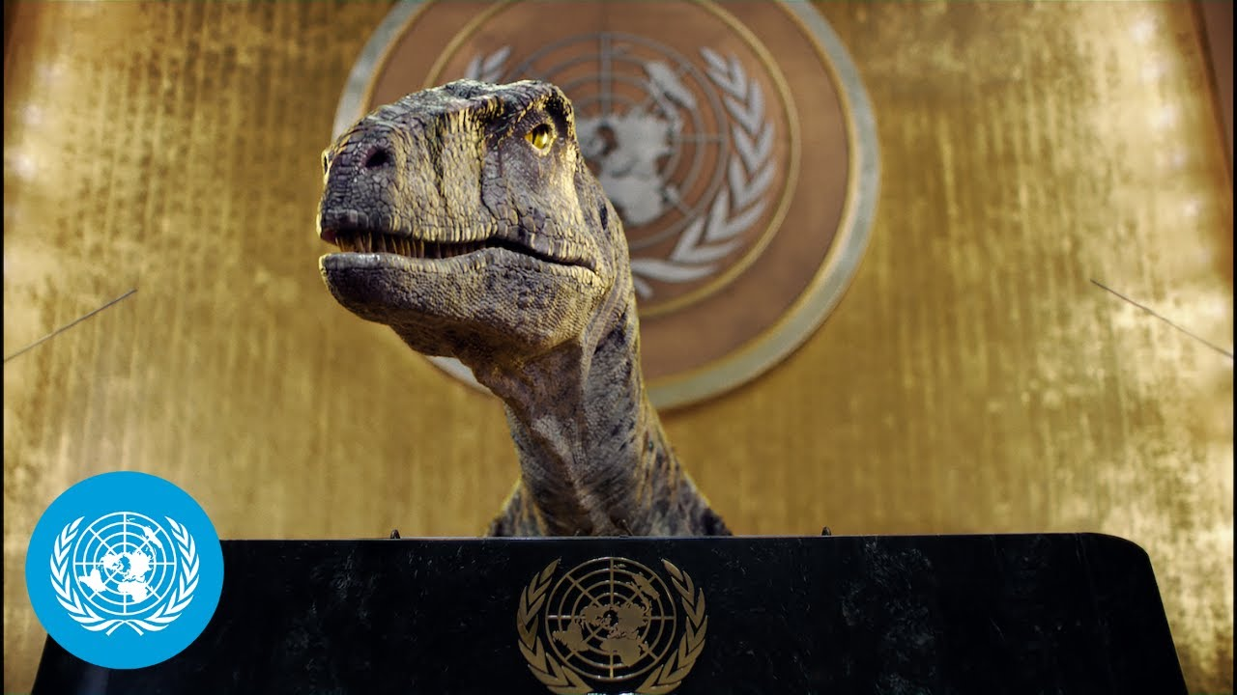

Slide 2
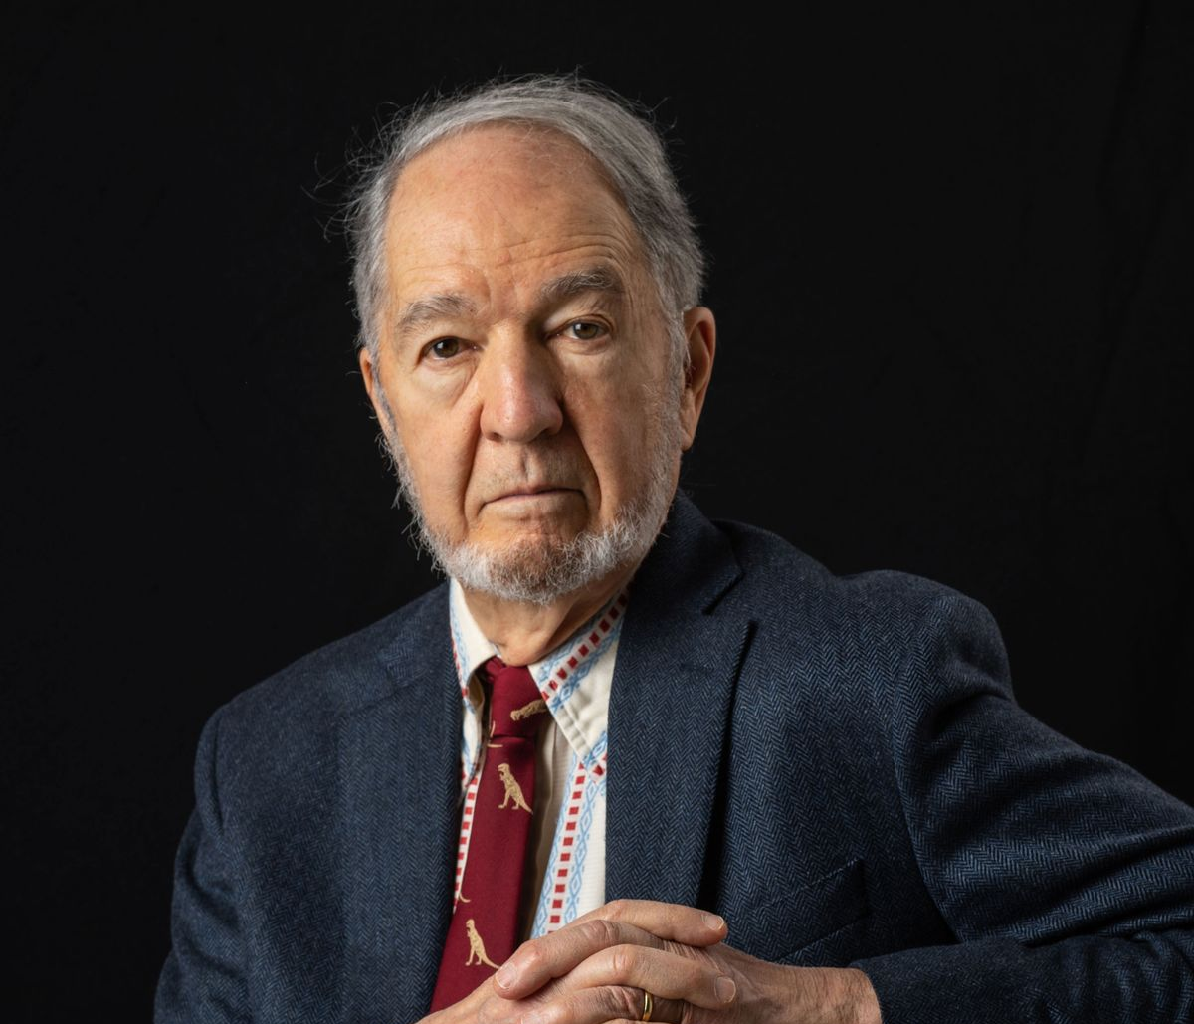

Slide 4
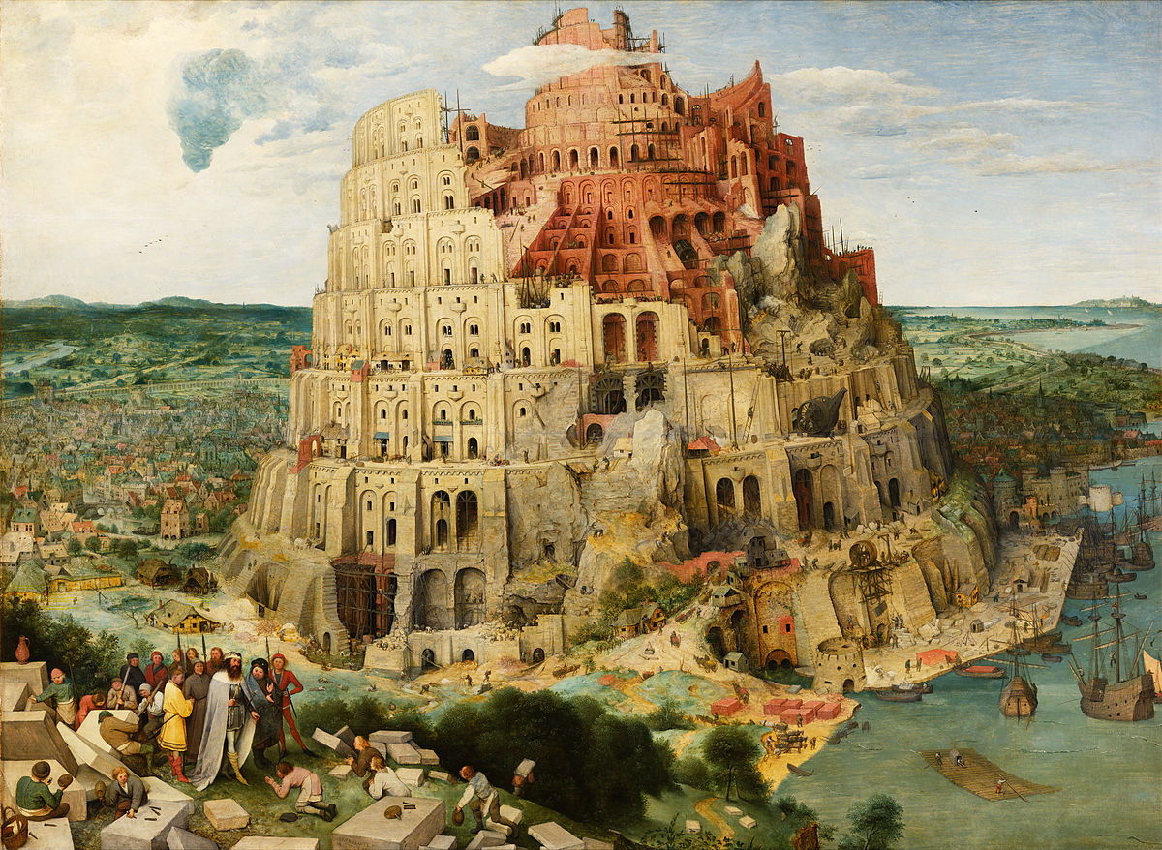

Slide 6
LET’S MAKE THE WORLD GREAT AGAIN
Picture by The New York Public Library from Unsplash

